Slide 1

Blueprint Document
Version 1.5

Slide 2
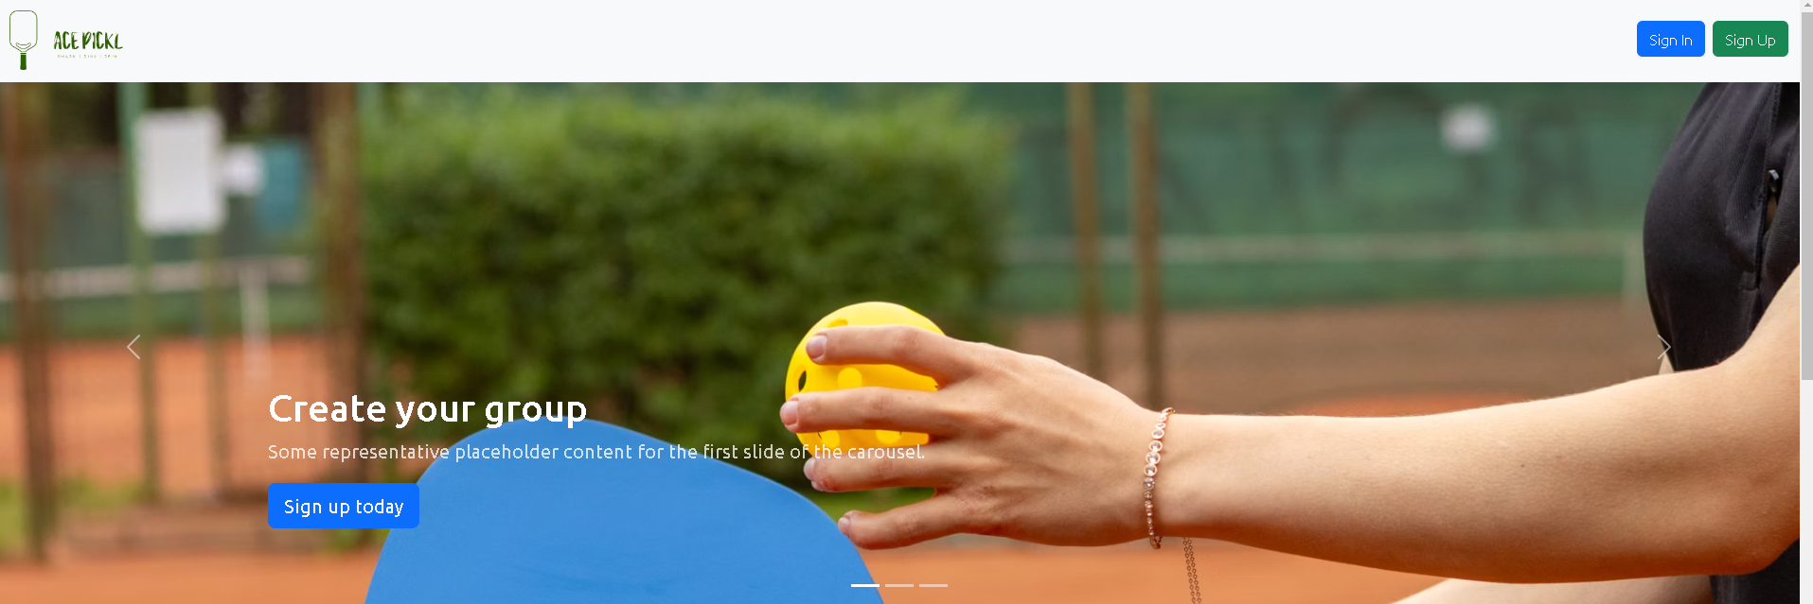
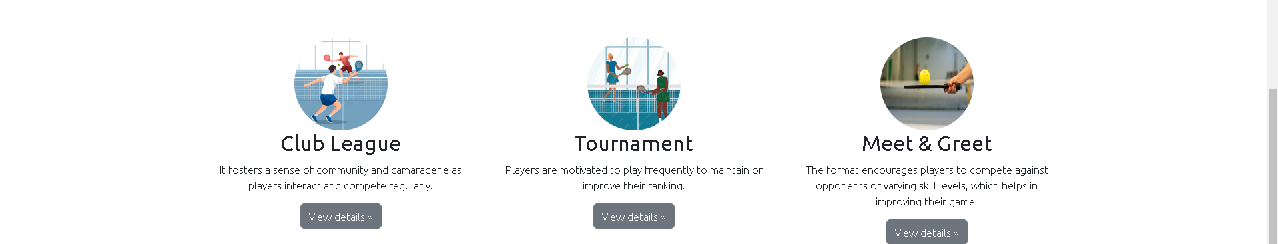
Home Screen – Page - 1

Slide 3
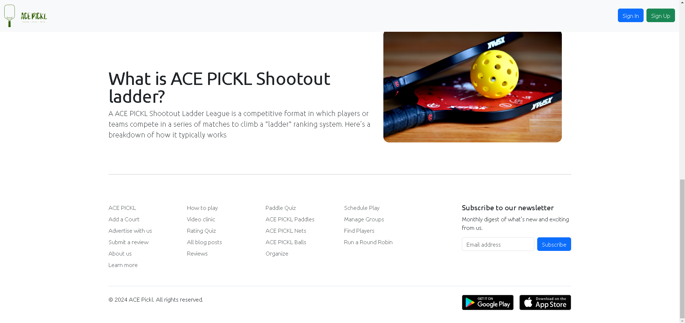
Home Screen – Page - 2

Slide 4
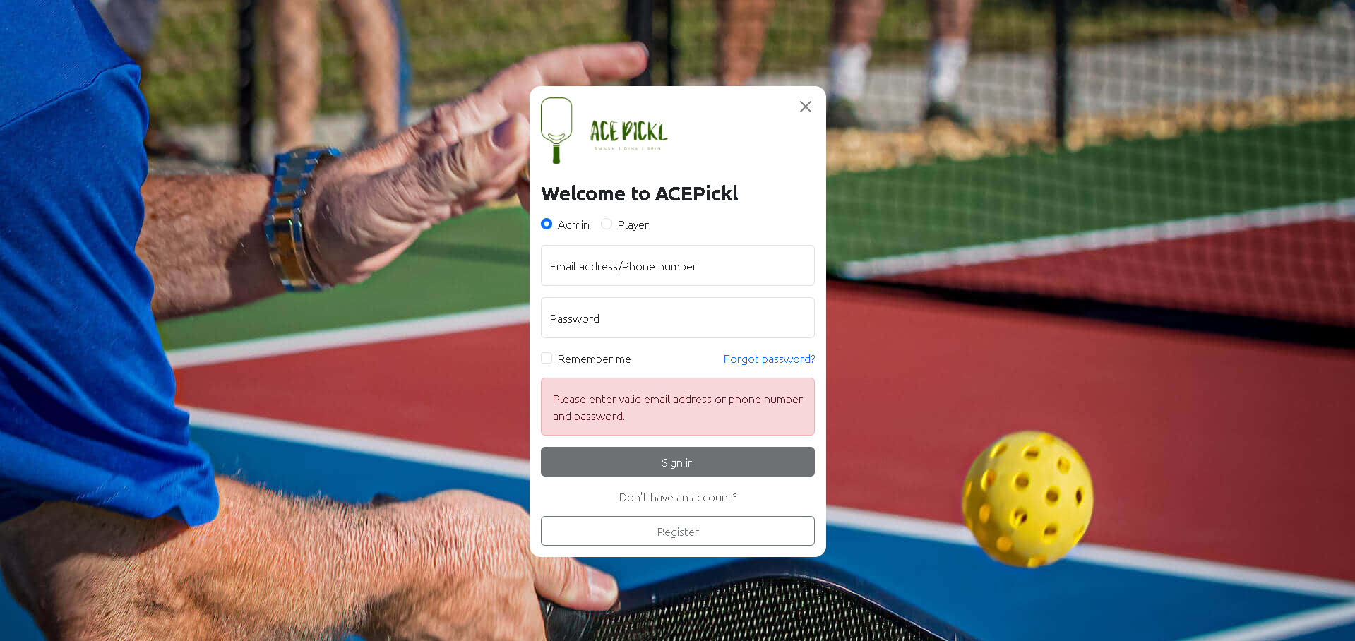
Login - Screen
Remove this

Slide 5
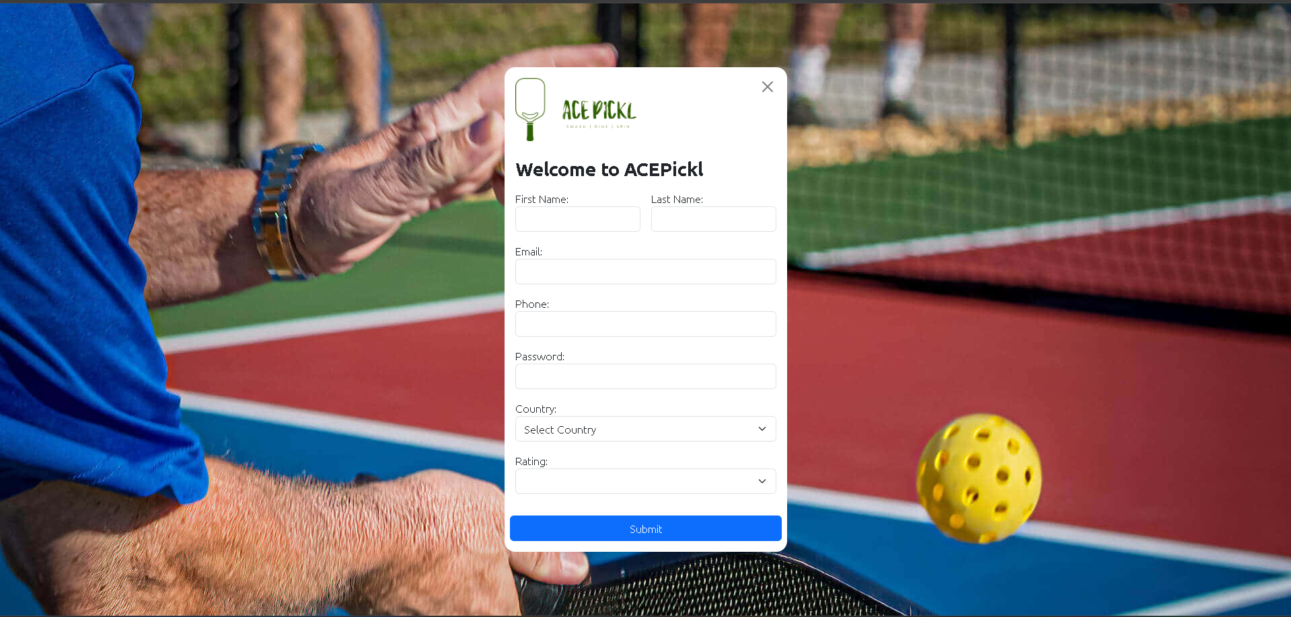
User Register - Screen

Slide 6
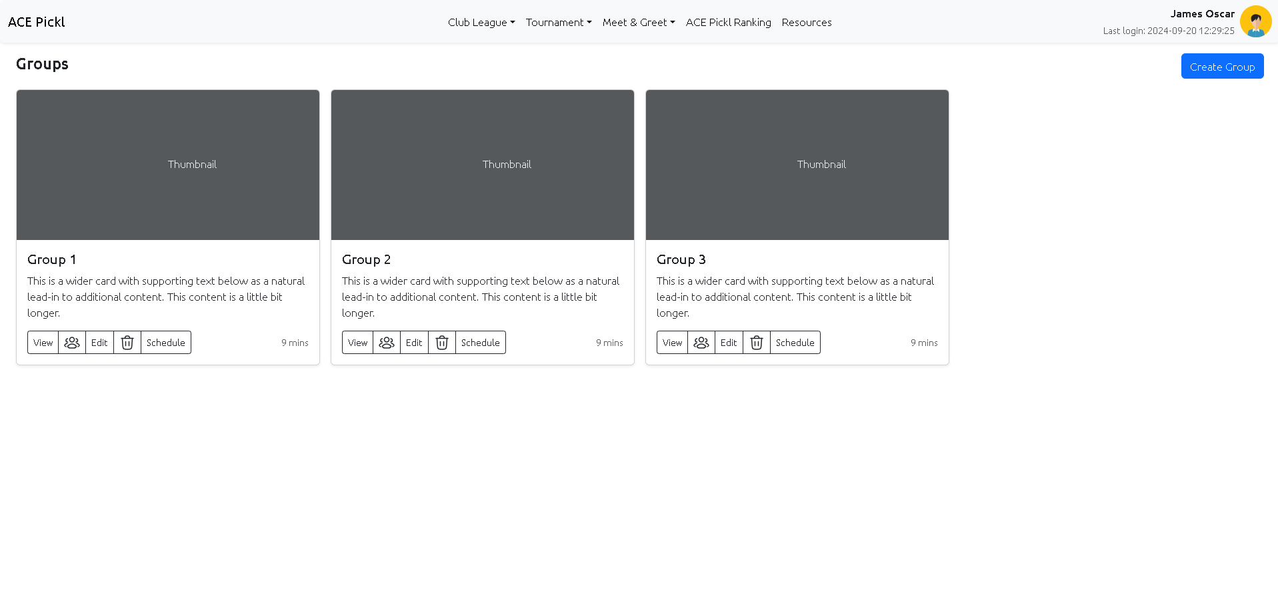
Club League - Group - Screen

Slide 7
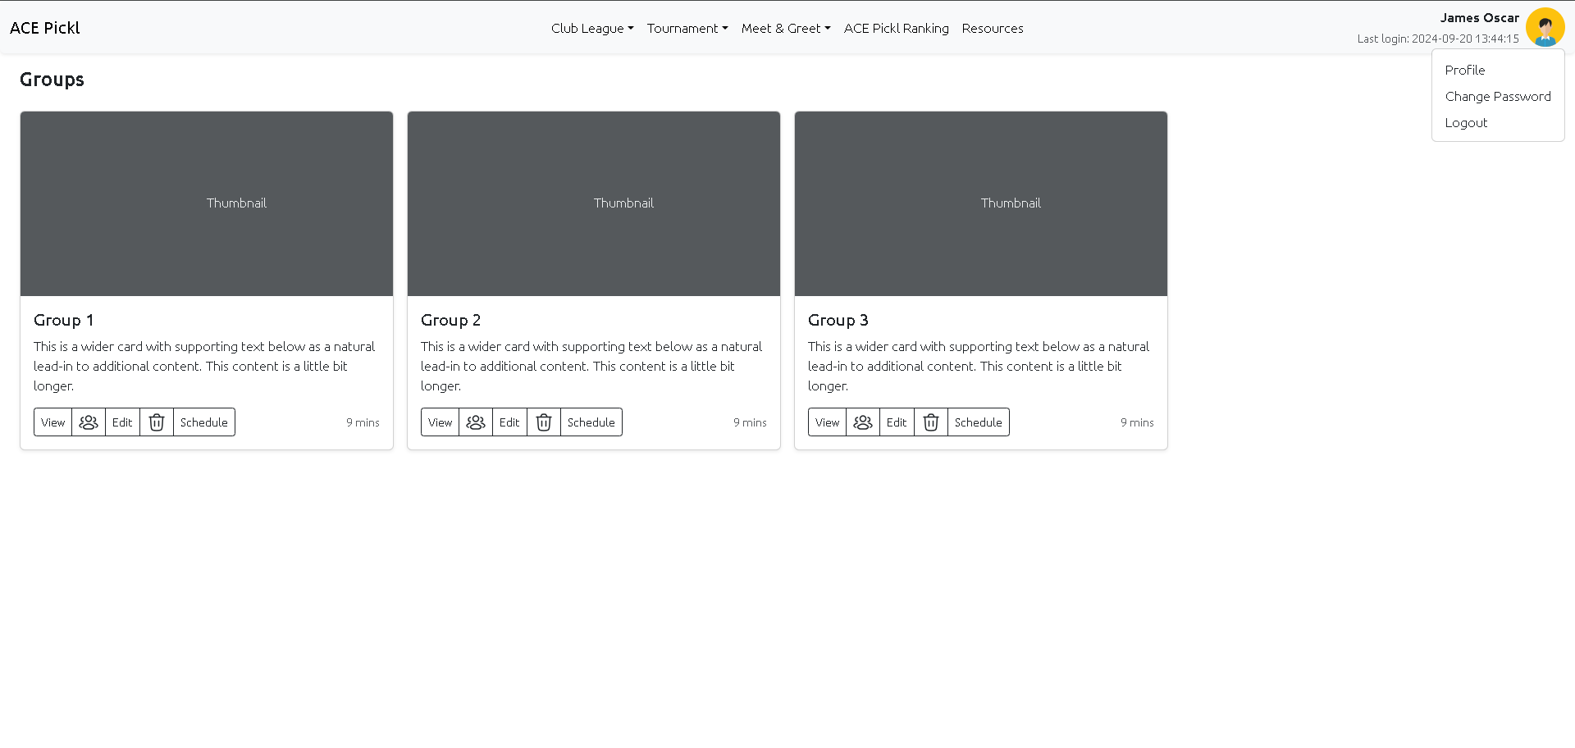
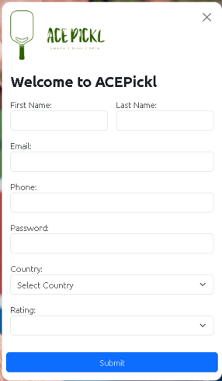
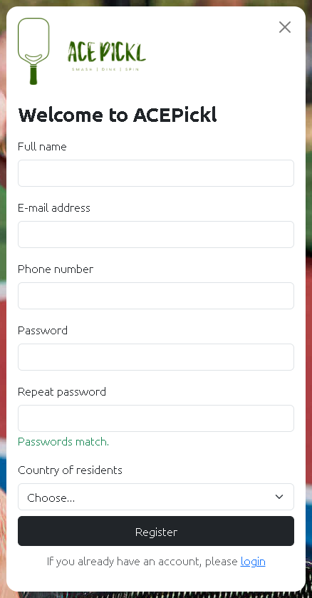
Update - 01
Date Of Birth
Change Password Functionality to be included
Age (Optional)
Address
Logo Missing
Map Location
Profile Picture

Slide 8
Group
Schedule
Court
Group
Schedule
Court
Connect
Chat
Schedule
Court

Slide 9
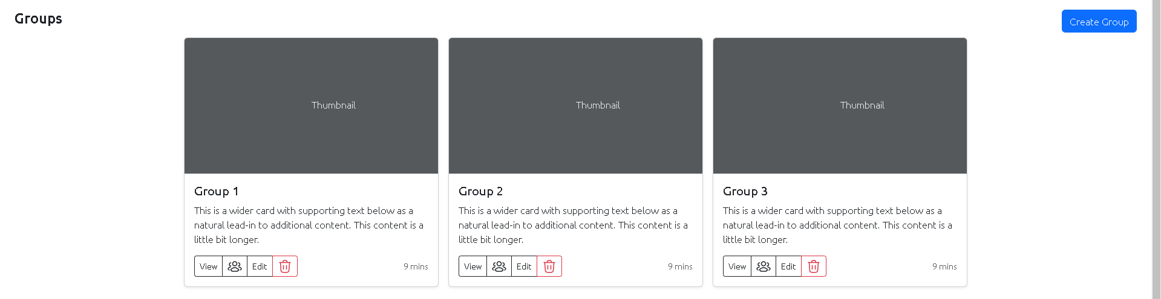
Schedule
View Group
Edit Group
Create / Edit / View / Delete
Schedule / Shootout
Add / Remove / View Players
Delete Group

Slide 10
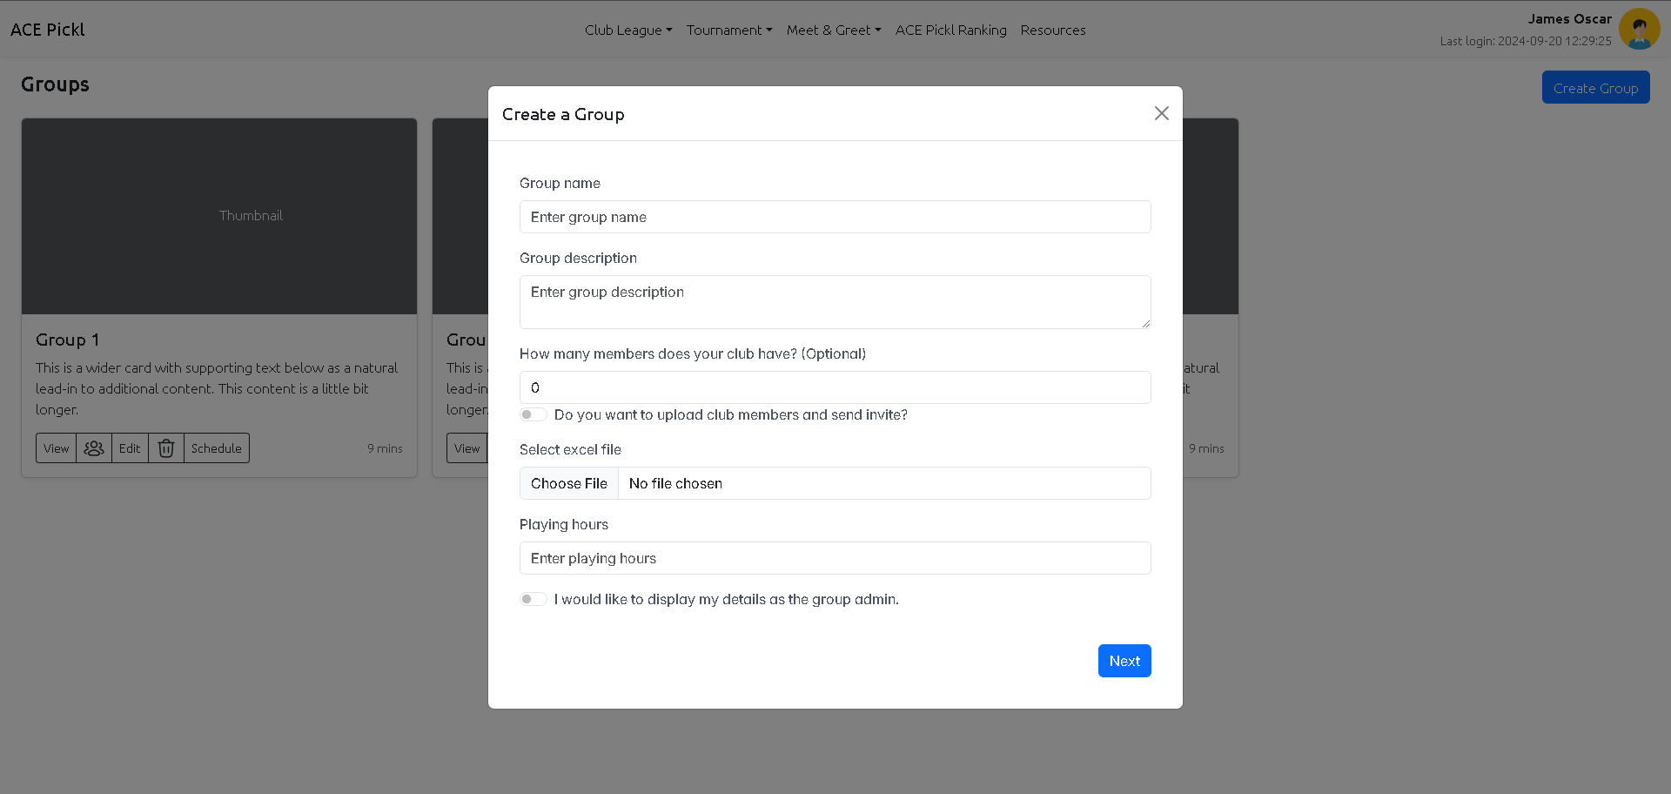
Club League - Group – Create – Screen - 1
Field Validation

Slide 11
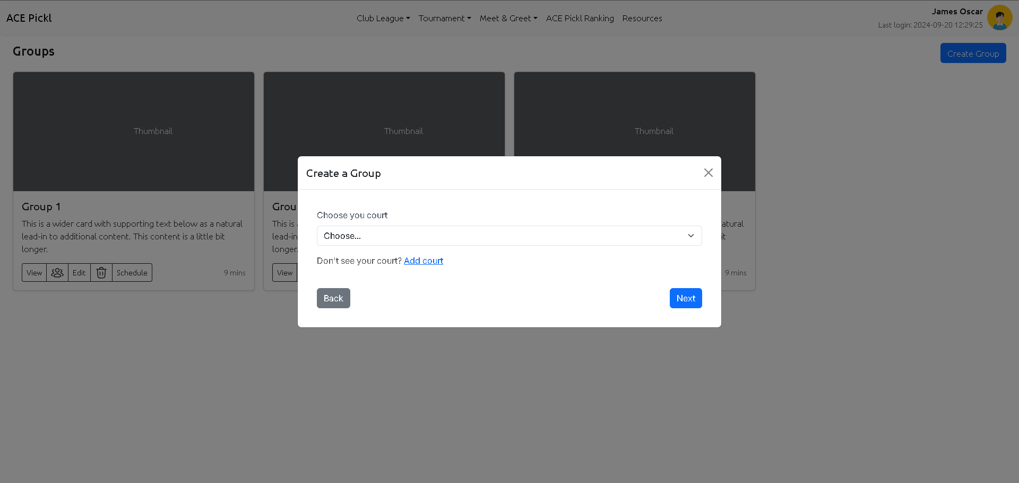
Club League - Group – Create – Screen - 2
Field Validation

Slide 12
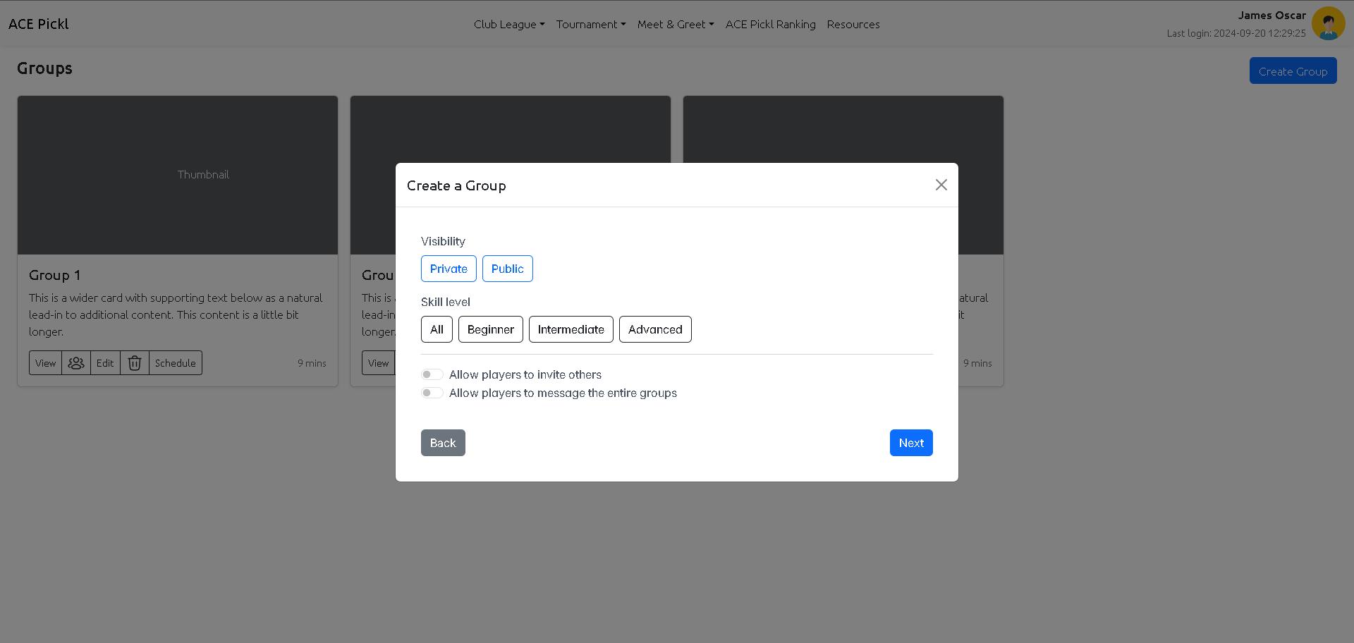
Club League - Group – Create – Screen - 3
Field Validation

Slide 13
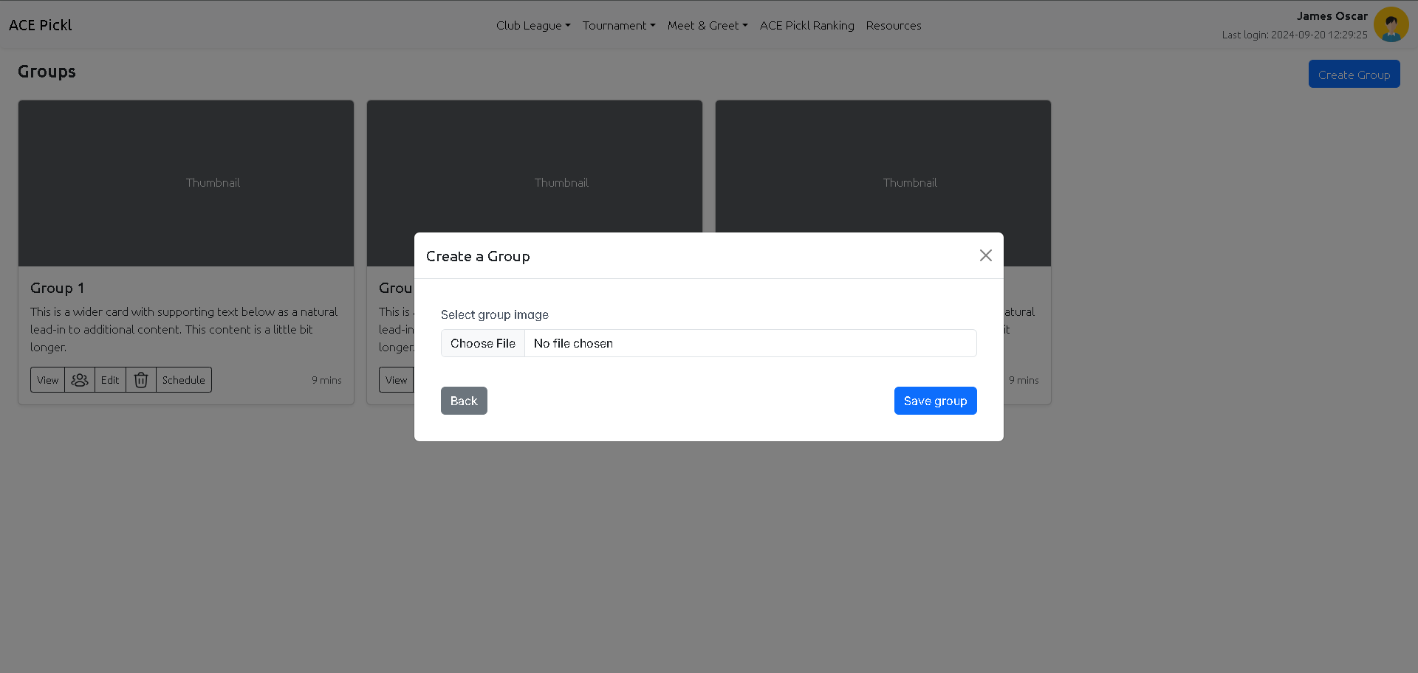
Club League - Group – Create – Screen - 4
Field Validation

Slide 14
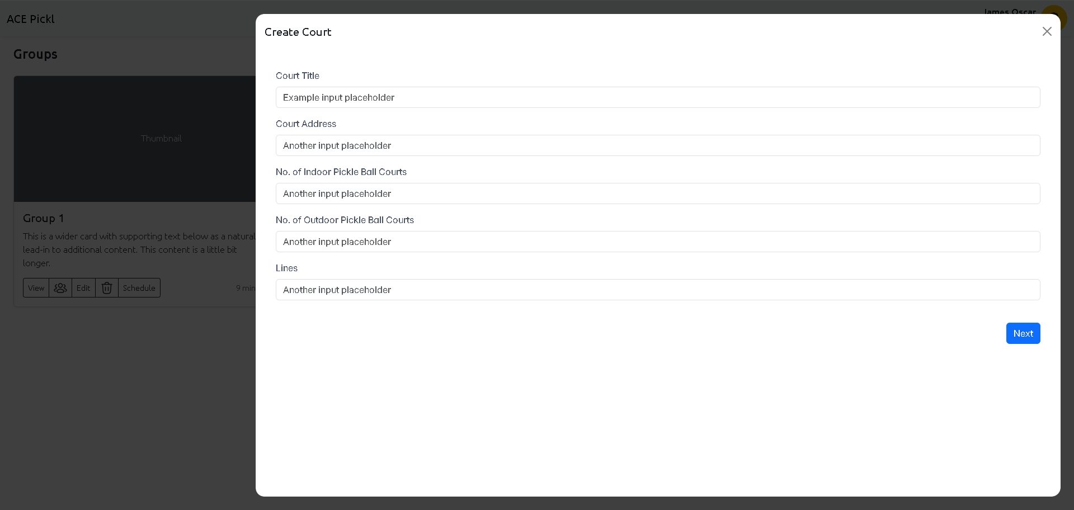
Club League - Court – Create – Screen - 1
Scree size
Field Validation

Slide 15
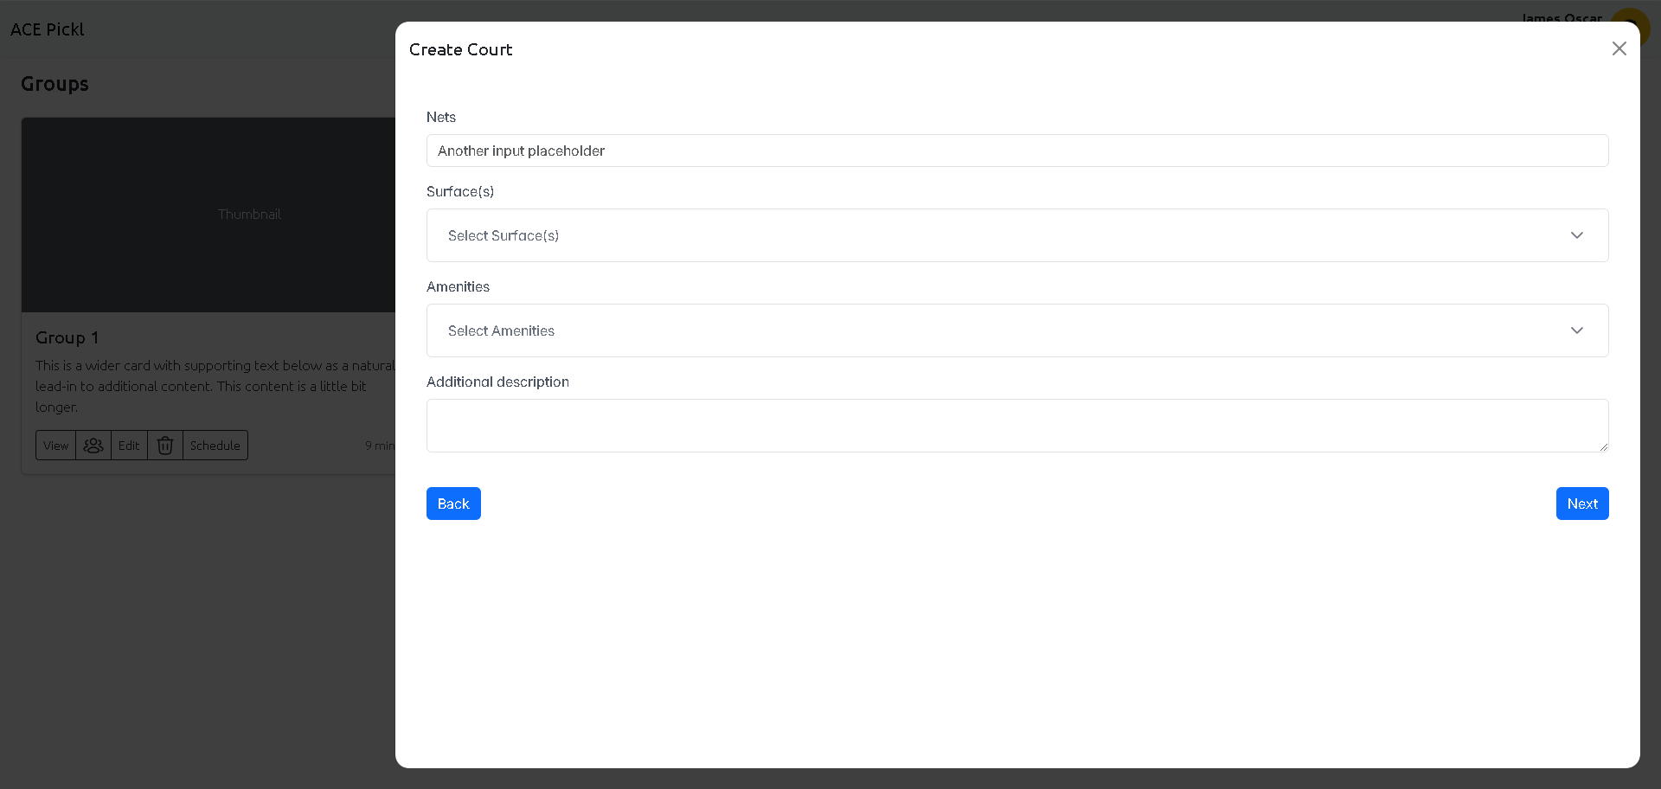
Club League - Court – Create – Screen - 2
Scree size
Field Validation

Slide 16

Club League - Court – Create – Screen - 3
Scree size
Field Validation
AM / PM

Slide 17
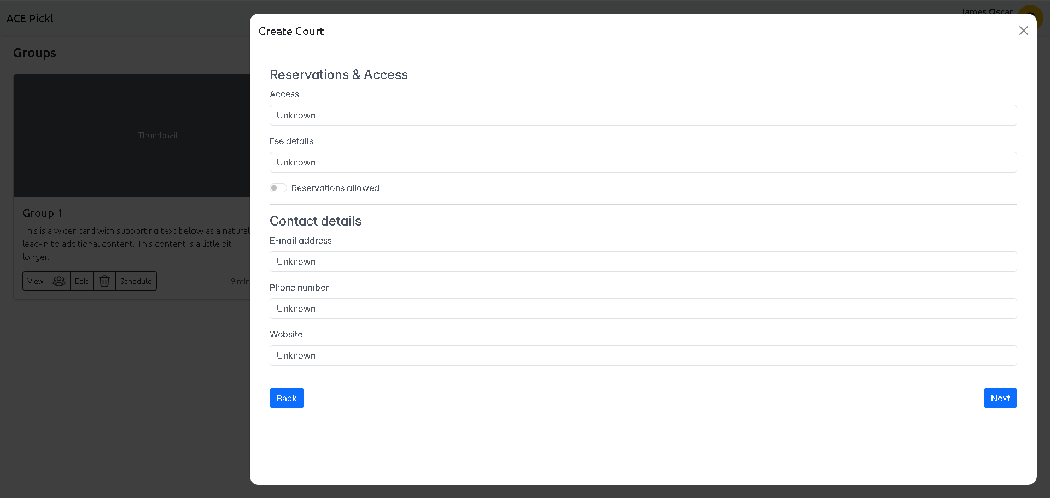
Club League - Court – Create – Screen - 4
Scree size
Field Validation

Slide 18
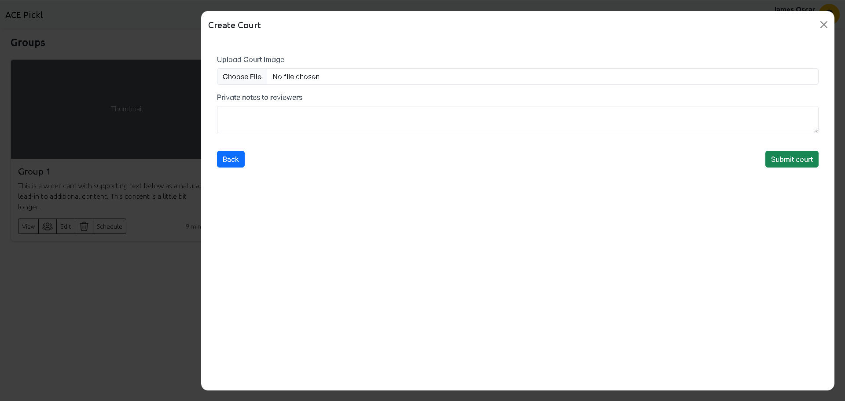
Club League - Court – Create – Screen - 5
Scree size
Field Validation

Slide 19
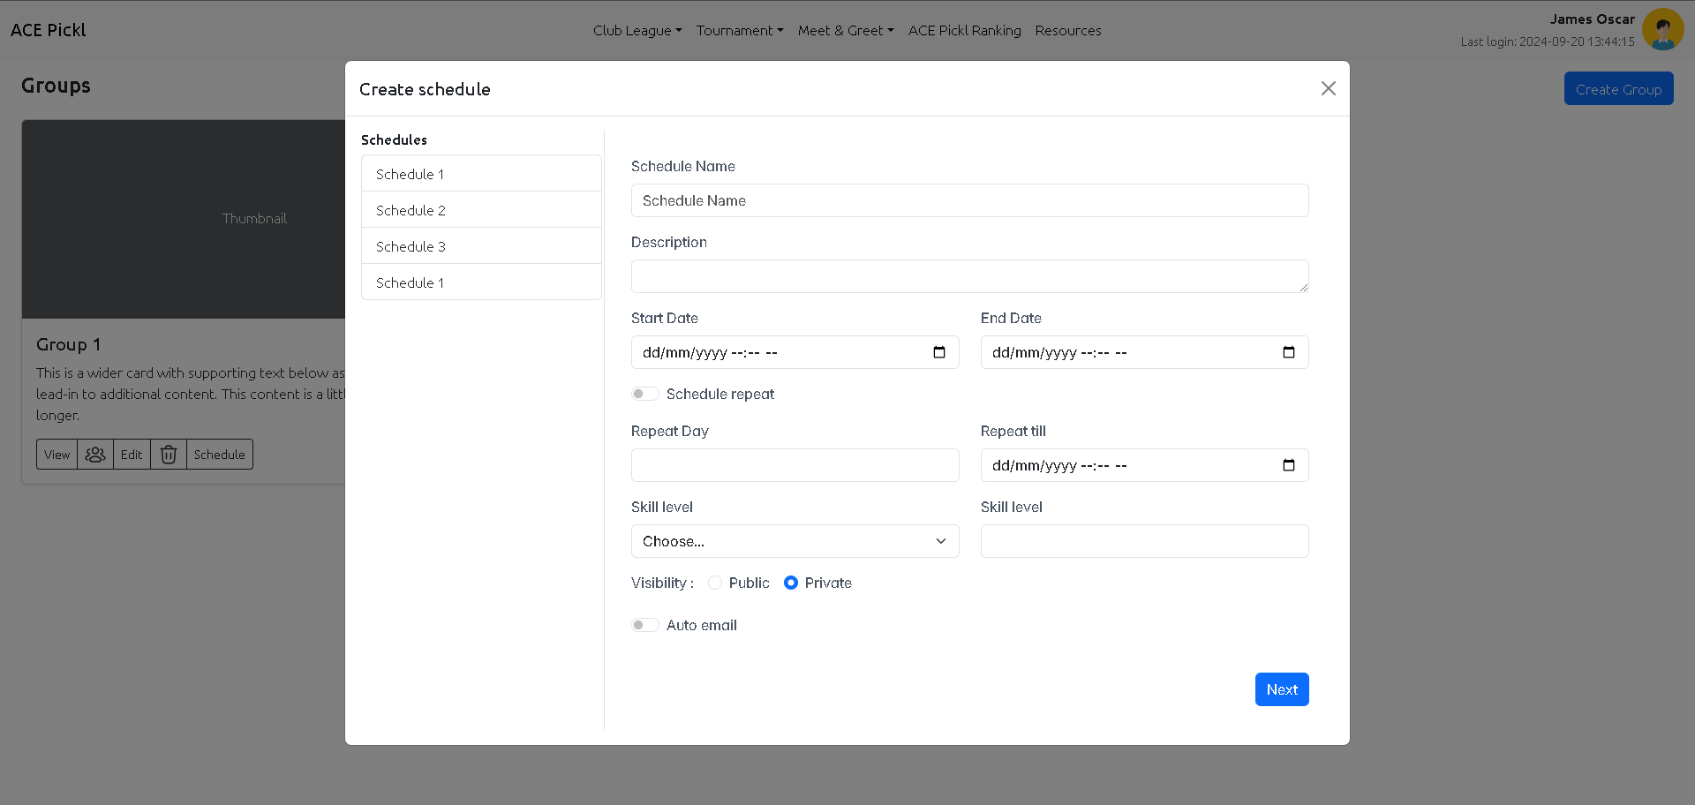
Club League - Schedule – Create – Screen - 1
Remove this section

Slide 20
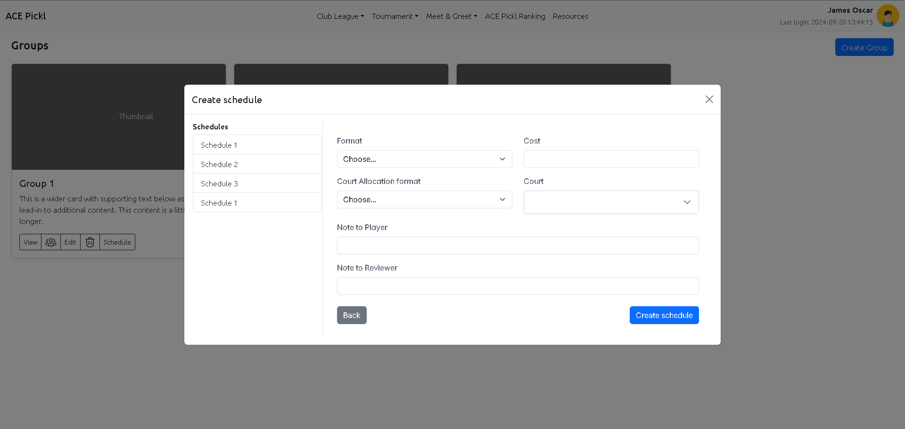
Club League - Schedule – Create – Screen - 2
Schedule Valid Hours

Slide 21
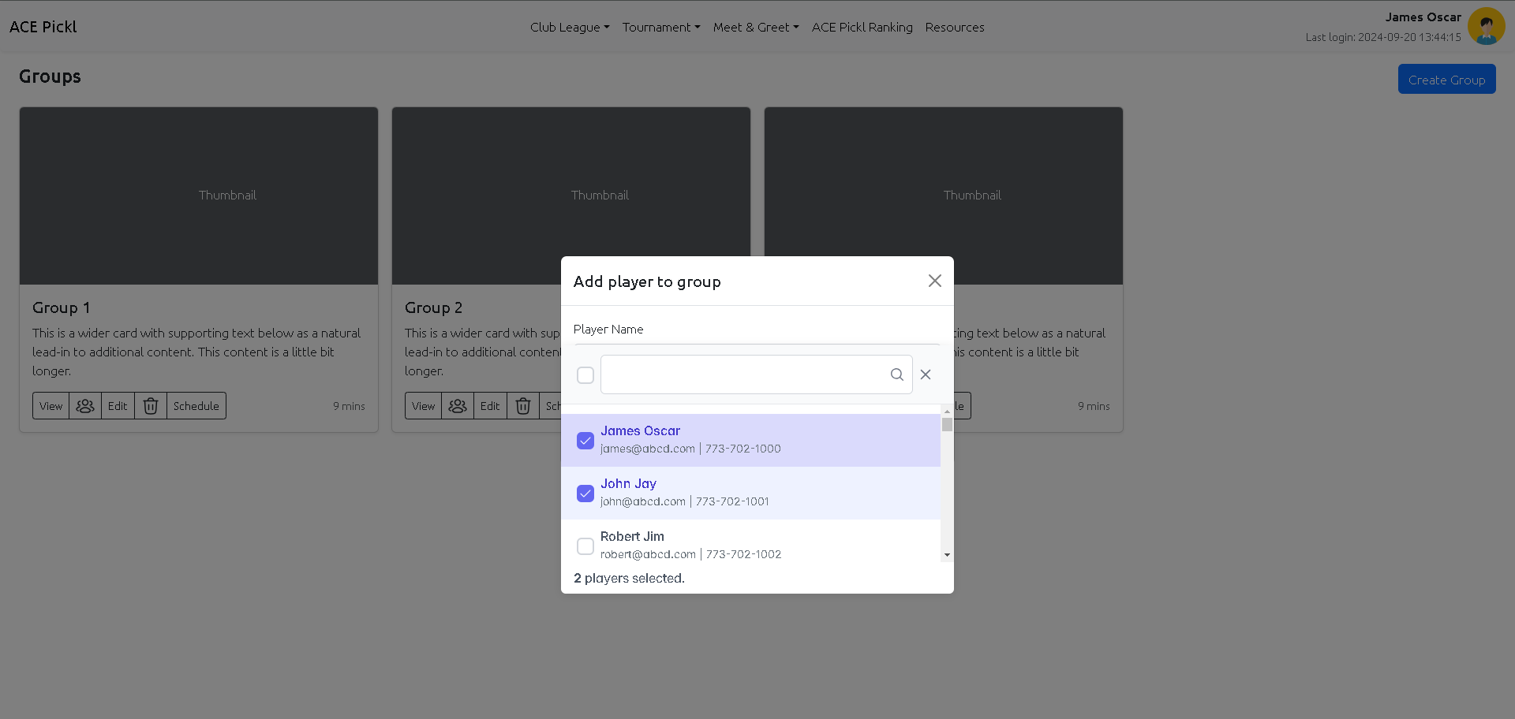
Club League - Player – Add – Screen

Slide 22
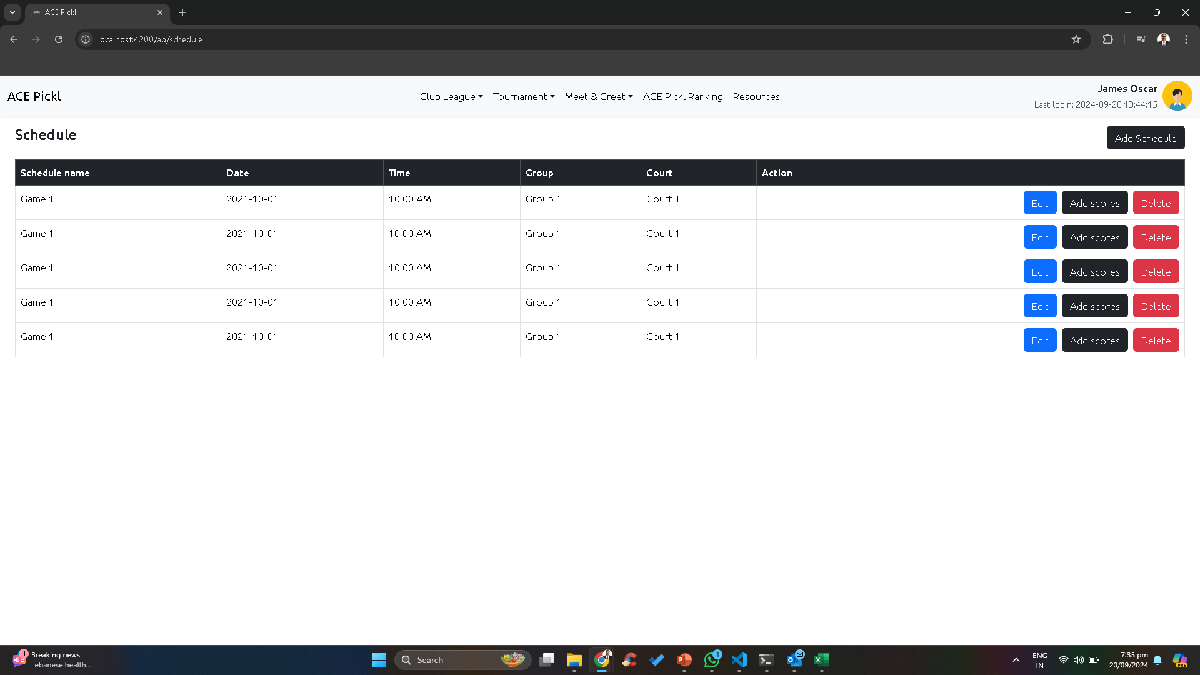
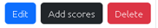
Club League - Schedule – List – Admin Login
Select Group
User Action whether he has to accept / reject / opt out
User Action
Launch
Player Summary
Team Details
When click on the schedule, the complete details to be shown with users and their status
Shootout / Schedule to be sent to the users via email / sms / whatsapp to register in the schedule
james | james@abcd.com | 773-702-1000
john | john@abcd.com | 773-702-1001
robert | robert@abcd.com | 773-702-1002
michael | michael@abcd.com | 773-702-1003
william | william@abcd.com | 773-702-1004
david | david@abcd.com | 773-702-1005
richard | richard@abcd.com | 773-702-1006
charles | charles@abcd.com | 773-702-1007
Accepted
All users scored to be uploaded via Excel
Accepted :10
Rejected :5
Optout: 2
Waiting List : 8
Total Users : 25
Waiting
Edit the Schedule
Delete the schedule

Slide 23
Club League - Schedule – List – Player Login
Select Group
User Action
Player Summary
Team Details
When click on the schedule, the complete details to be shown with users and their status
james | james@abcd.com | 773-702-1000
john | john@abcd.com | 773-702-1001
robert | robert@abcd.com | 773-702-1002
michael | michael@abcd.com | 773-702-1003
william | william@abcd.com | 773-702-1004
david | david@abcd.com | 773-702-1005
richard | richard@abcd.com | 773-702-1006
charles | charles@abcd.com | 773-702-1007
Accepted
Accepted :10
Rejected :5
Optout: 2
Waiting List : 8
Total Users : 25
Waiting
All users scored to be uploaded via Excel
User Action whether he has to accept / reject / opt out
Accepted :10
Rejected :5
Optout: 2
Waiting List : 8
Total Users : 25

Slide 24
Club League - Schedule – List – All Login
Select Group
User Action
Player Summary
Team Details
Request
When click on the schedule, the complete details to be shown with users and their status
james | james@abcd.com | 773-702-1000
john | john@abcd.com | 773-702-1001
robert | robert@abcd.com | 773-702-1002
michael | michael@abcd.com | 773-702-1003
william | william@abcd.com | 773-702-1004
david | david@abcd.com | 773-702-1005
richard | richard@abcd.com | 773-702-1006
charles | charles@abcd.com | 773-702-1007
Accepted
Accepted :10
Rejected :5
Optout: 2
Waiting List : 8
Total Users : 25
Waiting
All users scored to be uploaded via Excel
User Action whether he has to accept / reject / opt out
Accepted :10
Rejected :5
Optout: 2
Waiting List : 8
Total Users : 25
Request to be sent other users.

